Slide 1

Implementation of eOffice in offices
and Directorates of CBIC
Moving to an electronic Office
By:
Sunil Singh Katiyar
Commissioner Central Tax Panchkula
On behalf of DGPM, New Delhi

Slide 2
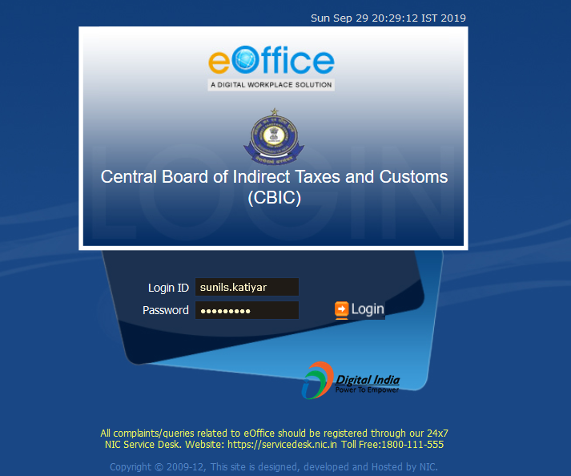
eOffice | Login page

Slide 3
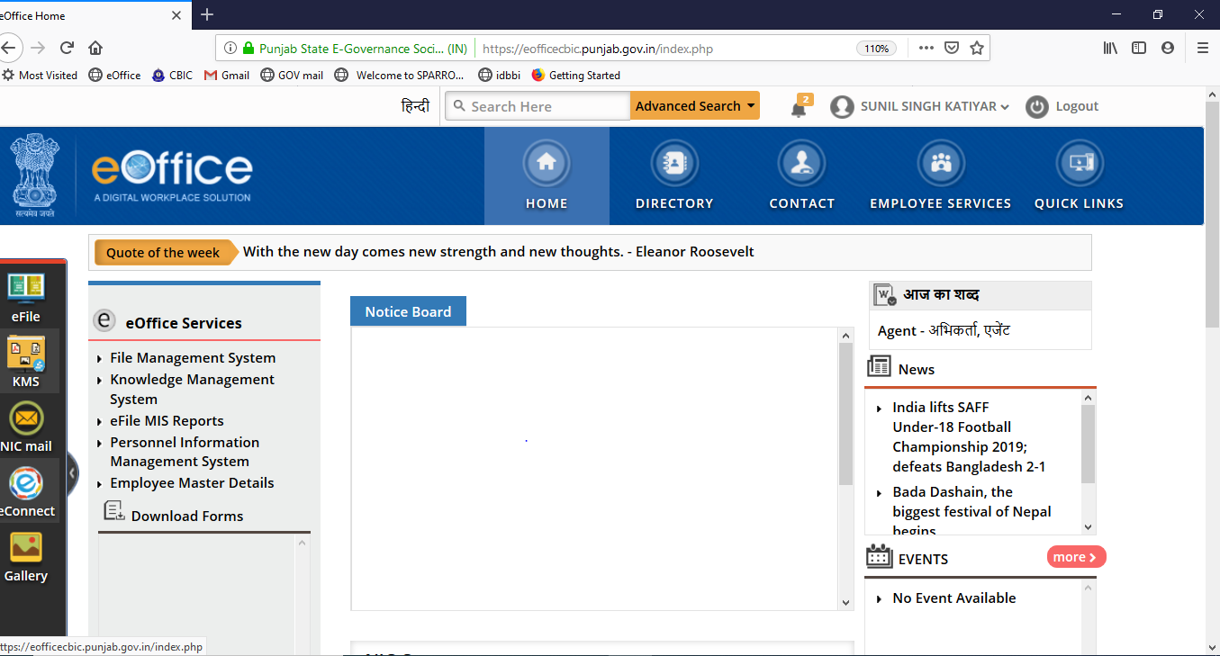
eOffice | Dashboard

Slide 4
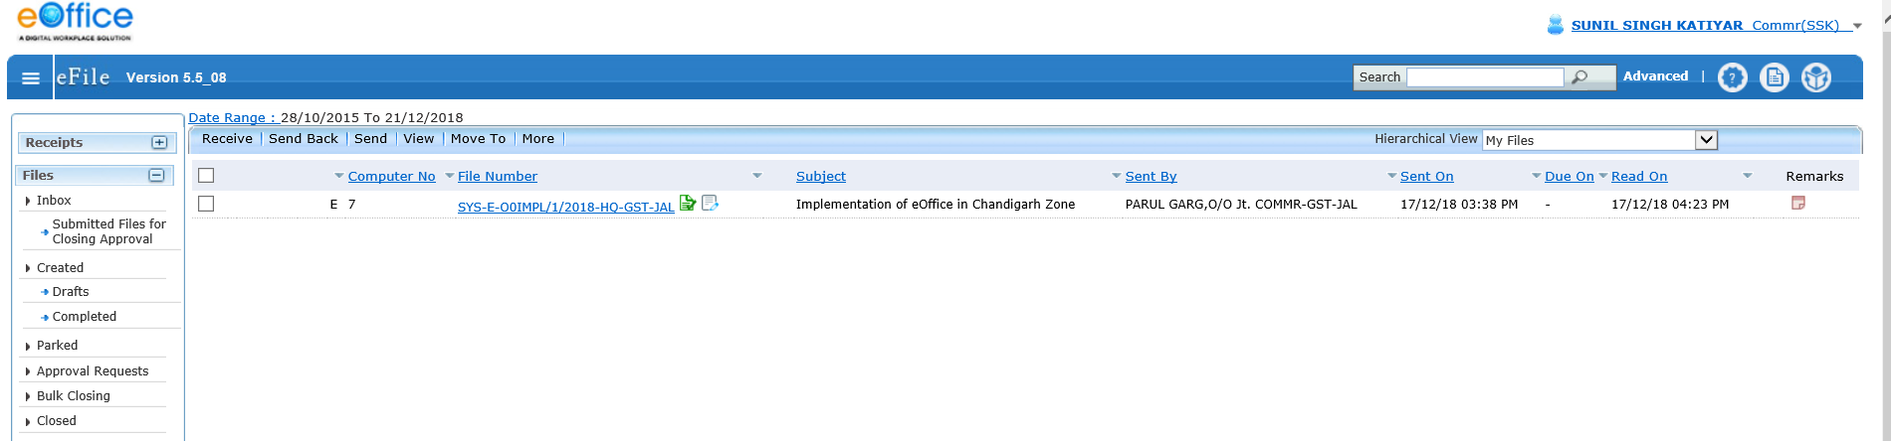
eFile Screen- All files and dak appear here

Slide 5
eFILE| What is eFile?
eFile is a workflow based system that replaces the existing manual handling of files with a more efficient electronic system. It is essentially a physical file in electronic mode. Everything that is/can be done on a physical file can be done on efile as well.
This system involves all stages including :
  Diarisation of inward receipts
  Creation of Files
  Movement of Receipts & Files
  The archival of records

Slide 6
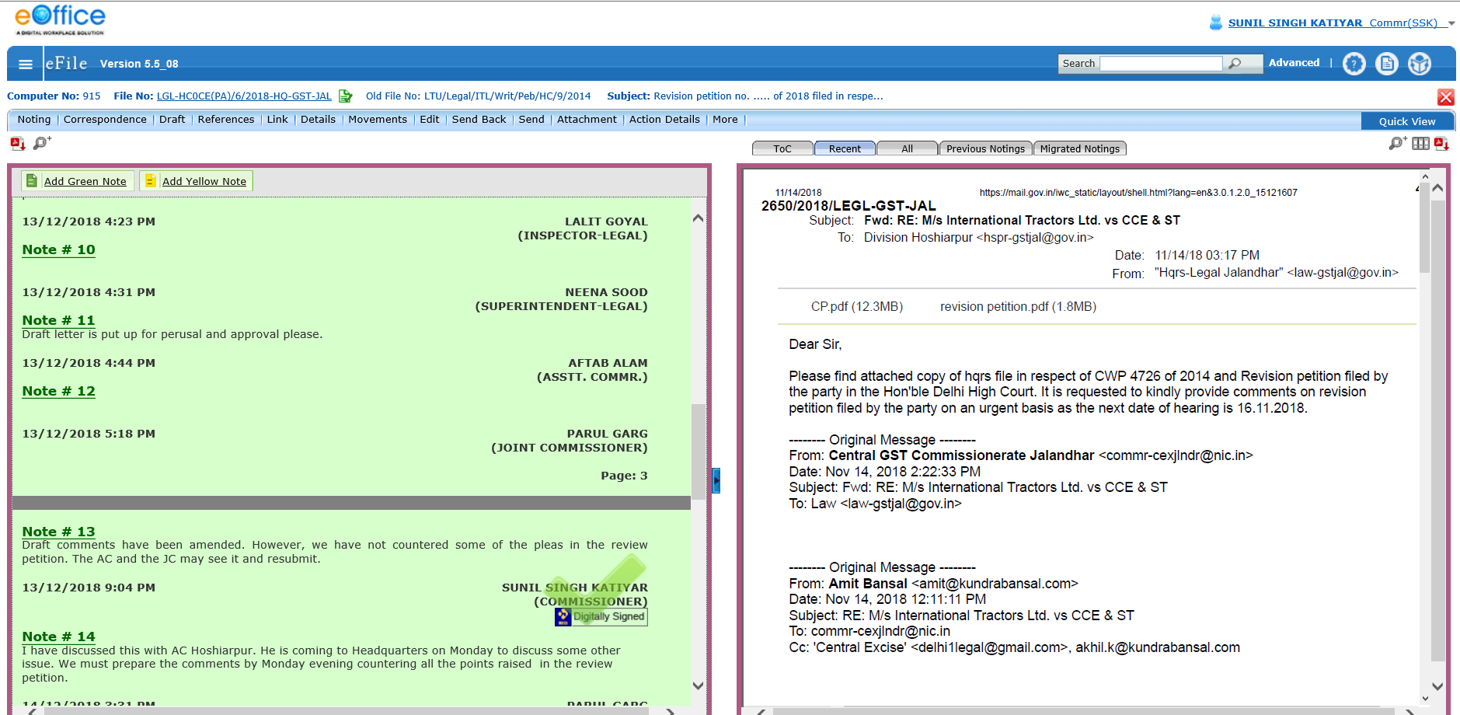
eFILE|- Note sheet and Correspondence side

Slide 7
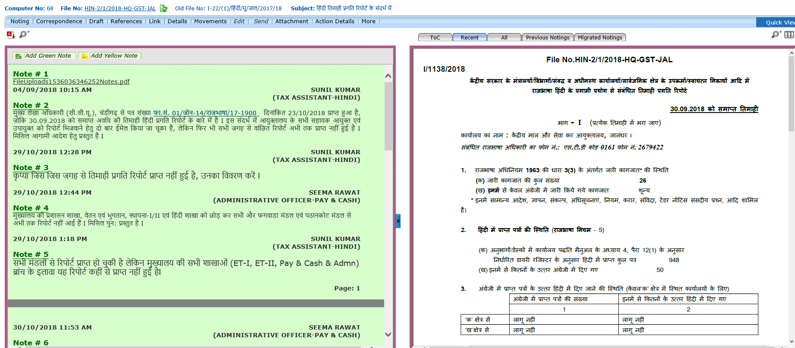
eFILE|
It facilitates use of Hindi as well.

Slide 8
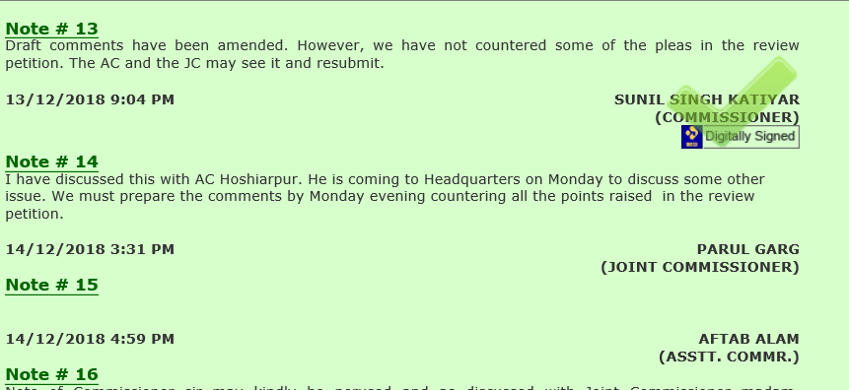
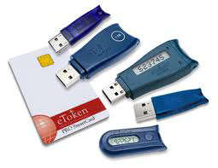
eFILE| - How to sign note sheet /letters
Electronic signature i.e. DSC/eSign can be used to digitally sign documents.
Electronic Signature (DSC/eSign)
Used for signing documents/ note sheet. It has the same legal recognition and validity as handwritten signatures u/s 5 of the IT Act, 2000. DSC is available in the form of a smart card or USB token. eSign is integrated with the application.
Notes:
Reference : DSC Handbook and eOffice HandBook

Slide 9
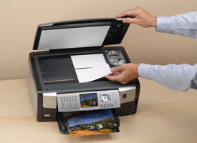

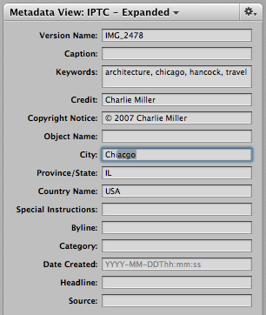
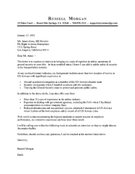
File Management System (eFile) – The Flow
First receiver scans
Upload directly to eOffice application
Enter Meta Data
System creates sequential Diary Number for each receipt
Send receipt to user concerned, in case CRU is first receiver
Store in Hard Drive
Create a new efile
Attach to current efile
Browse & upload
Enter Meta Data
System Creates a efile Number
e-file moves through the Channel of Submission on the system
Digitally Sign and send efile to next user
Open efile and start Noting, create draft/edit draft/approve draft/issue draft, referencing to drafts & correspondence sections within e-file

Slide 10
Please see the next PPT for remaining slides.

